Slide 1
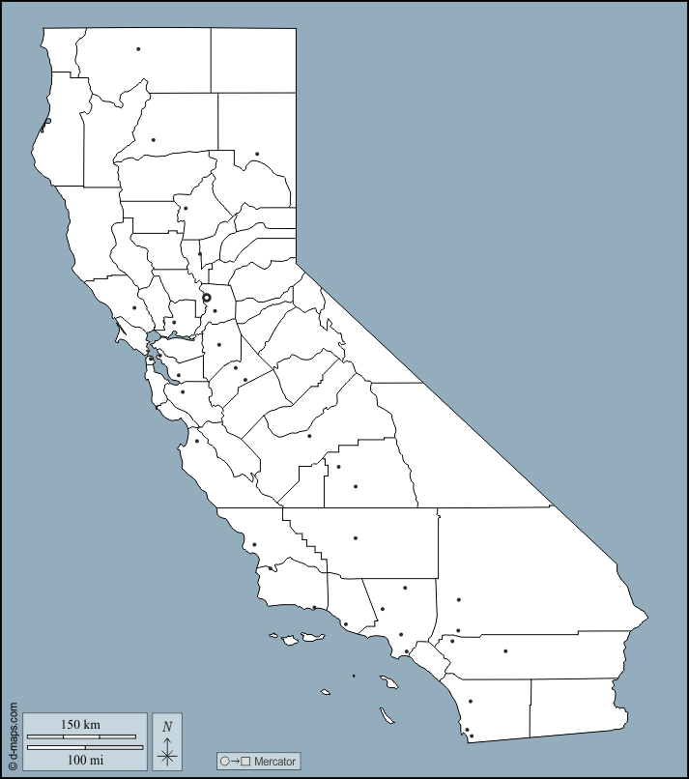
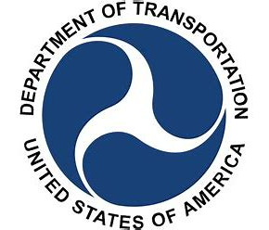

California Inland Port System
Project Briefing
November 2022
Tony Boren,
Executive Director
Fresno Council of Governments
Equivalent Distance From Washington DC to Boston Through 7 States and DC
Confidential

Slide 2
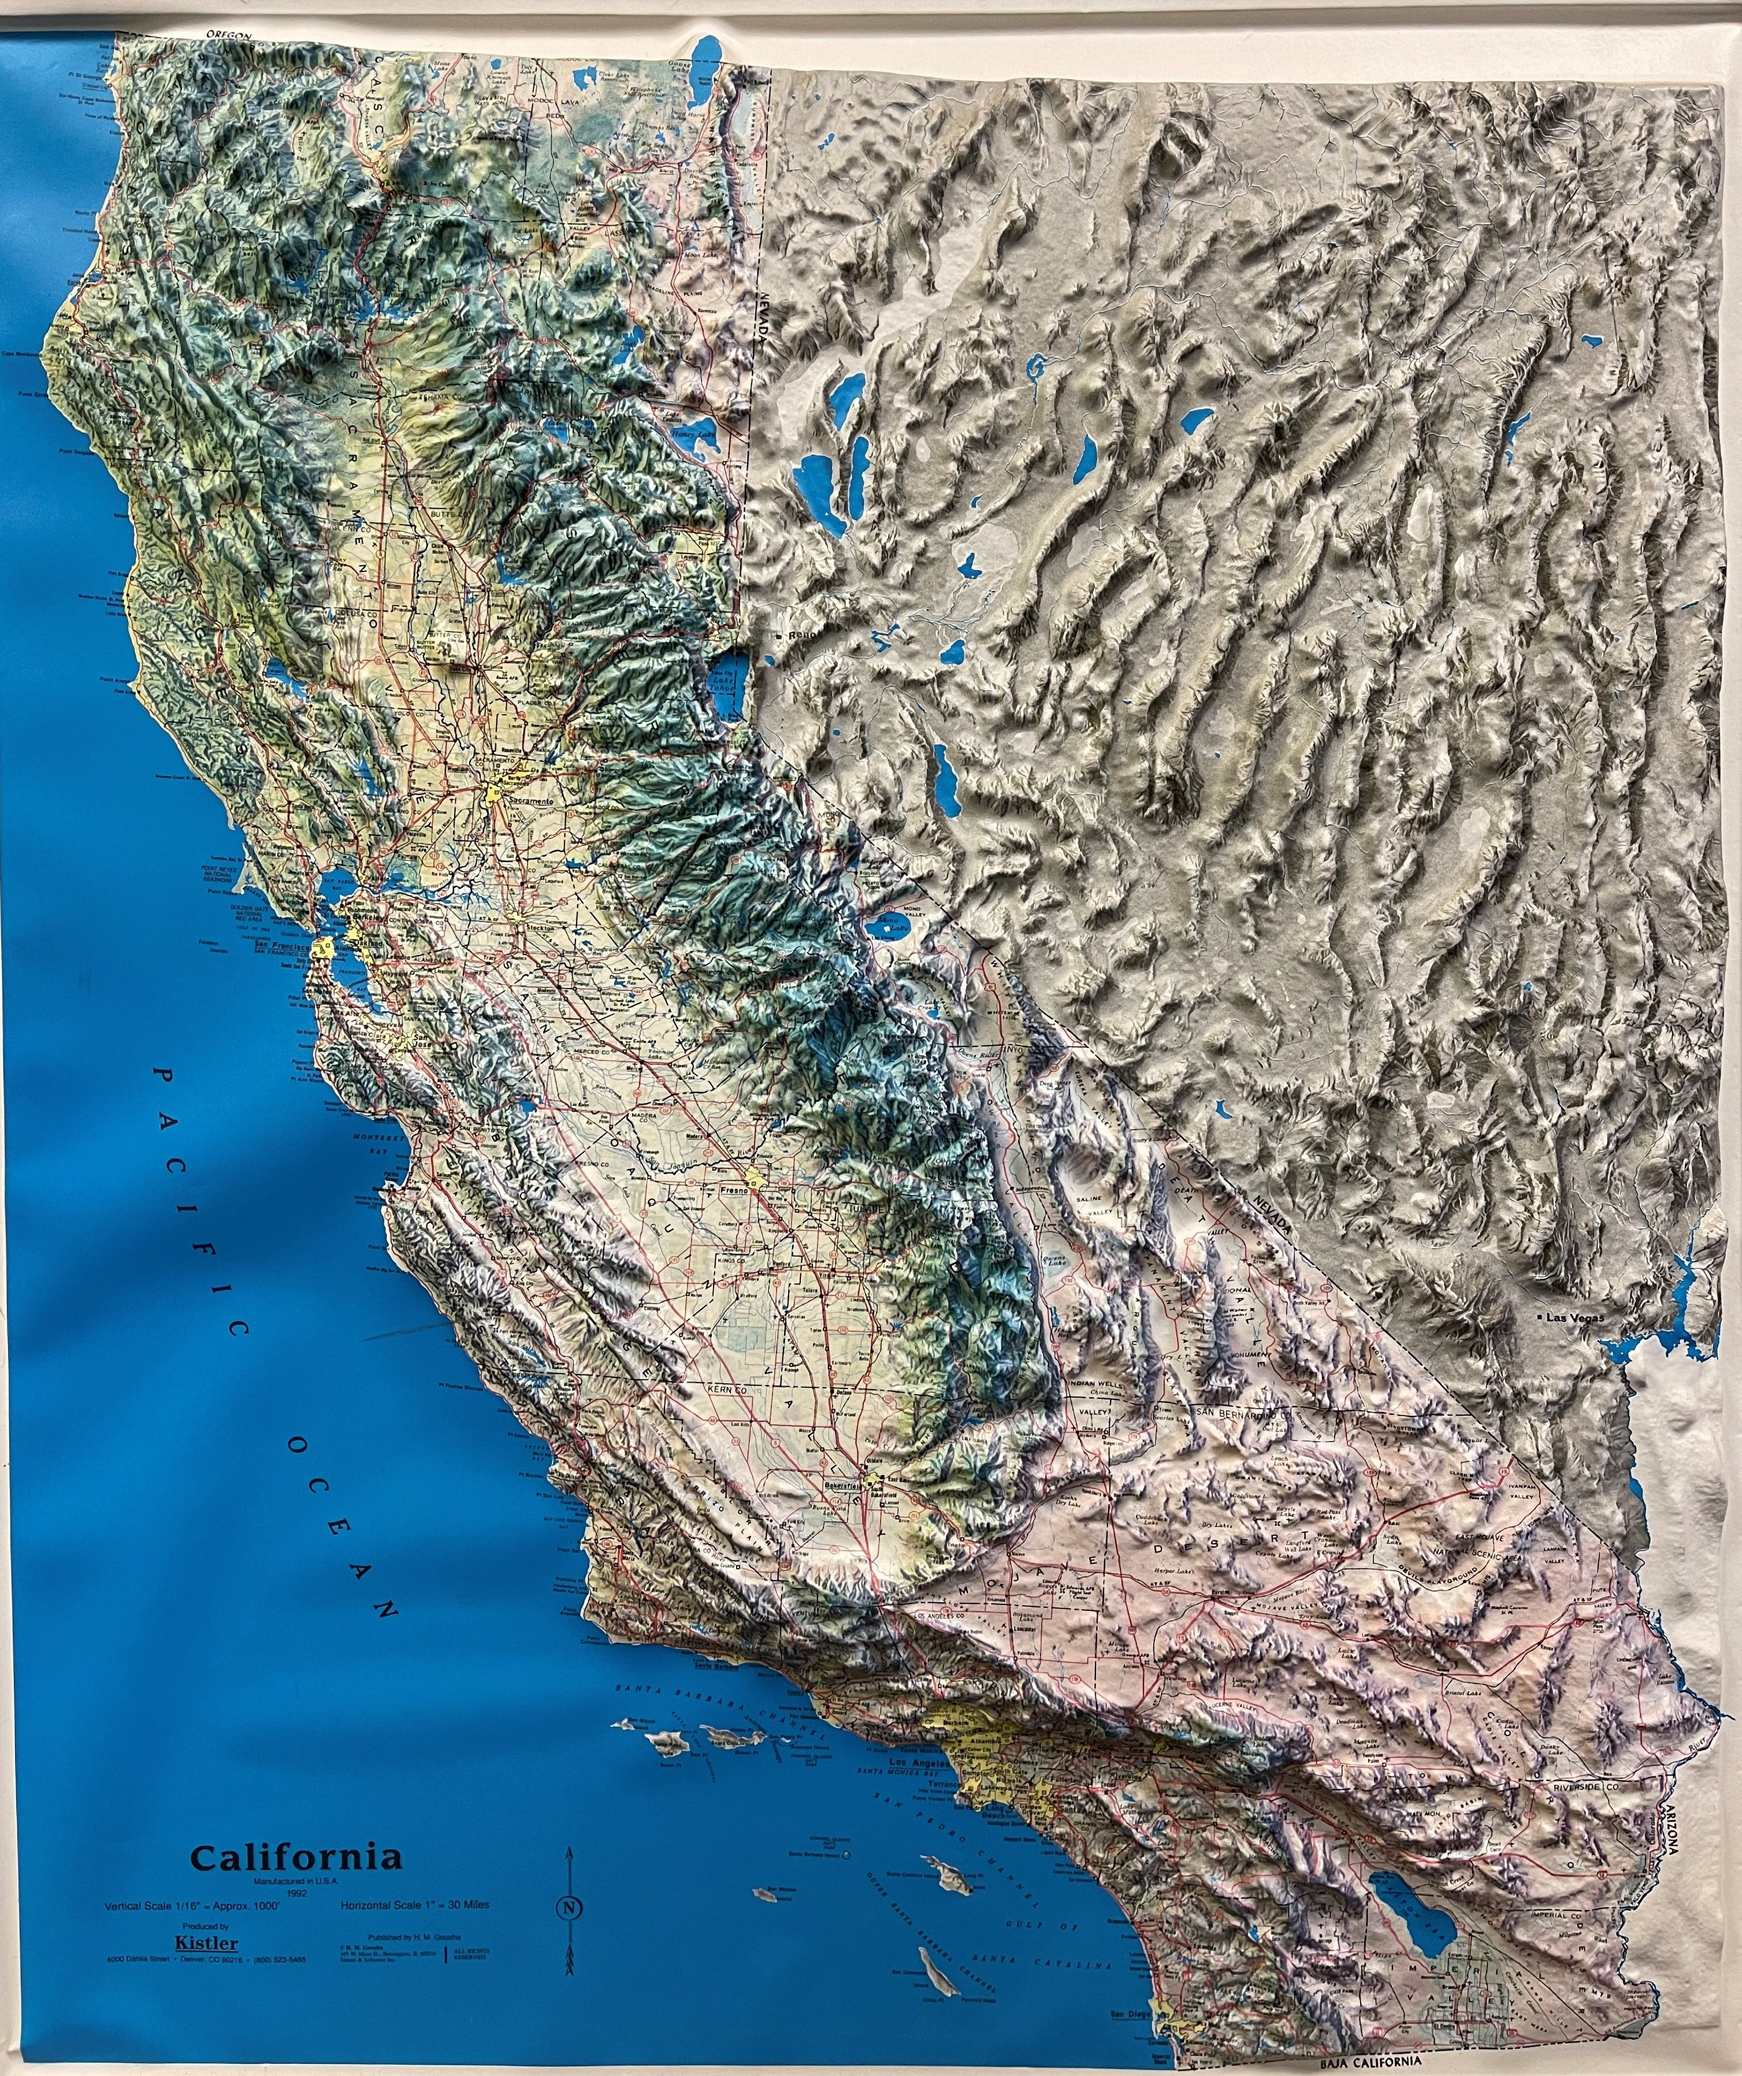
CAIPS Project-Goods Movement/Environmental/
Economic Benefits
The California Inland Port Project (CAIP) offers the opportunity to significantly address several goods movement and environmental challenges facing the San Joaquin Valley and Sacramento regions. The challenges are inherent to the regions and will continue to worsen if long term goods movement strategies are not developed and implemented over time.

Slide 3
Class One Railroads
In California

Slide 4
CAIPS-Project Objectives
Public Objectives:
  Contribute to a More Efficient National Supply Chain System
  Substantially Reduce GHG and Air Criteria Pollutants in California, Build Sustainability In At Project Core
  Significantly Increase Economic Competitiveness and Opportunity; Especially in Rural/Challenged Areas
  Reduce VMT, Road Congestion, and Maintenance Costs, Increase Traffic Safety Through Mode Shift
  Build Around Social Equity and Environmental Justice Needs
  Promote Collaboration and Partnership Across The Public and Private Sectors
  Provides an opportunity to address the agricultural export challenges facing San Joaquin Valley growers.

Slide 5
CAIPS- Supply Chain/Goods Movement Benefits
The CAIP will be addressing the national supply chain crisis by providing a platform to address existing and future agricultural export challenges facing growers in the San Joaquin Valley and Sacramento regions. Inland Port will be a public-private platform to transform much of the California logistics system to become the cleanest, most sophisticated supply chain system in the world. From its genesis, the project has been developed in coordination with the Port of Los Angeles/Long Beach and will establish higher efficiencies through new strategic mobility hubs, sustainable technologies, and business partnerships

Slide 6
CAIPS-Environmental Benefits
If implemented, the CAIP will significantly reduce vehicle miles travelled, air pollution, and greenhouse gas emissions by reducing the number of truck trips from the seaports in Los Angeles/Long Beach to the San Joaquin, Sacramento and SF Bay Area regions.
The California Inland Port project and its utilization of sustainable energy will reduce greenhouse gasses emitted in the San Joaquin Valley, Sacramento and Los Angeles regions and complements the State Route 99 Multimodal Corridor study which is currently underway. It will be a catalyst for the transition to a clean fleet of heavy trucks while providing the opportunity to serve as future hydrogen hubs for California’s hydrogen highway.

Slide 7
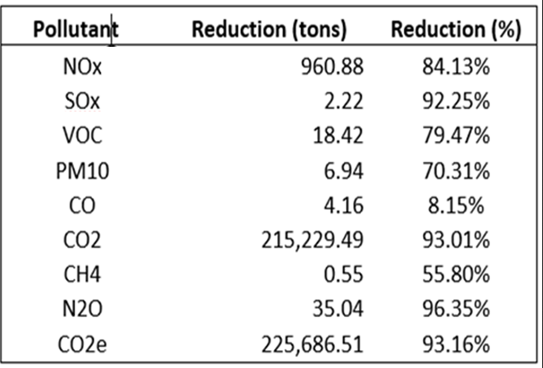
Environmental Benefits
Analysis performed by the San Joaquin Valley Air Pollution Control District shows a significant reduction in annual emissions if all truck cargo was moved to rail or zero-emission trucks.
NOx Emissions would be reduced by up to 84% while Greenhouse Gas emissions would be reduced by up to 93%
Reduction of truck congestion around San Pedro Bay Port Complex and Port communities (emission reductions not modeled)
Confidential

Slide 8
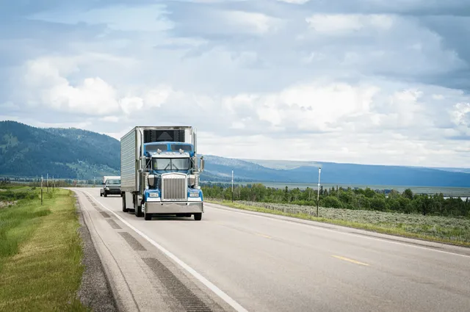
Background of CAIPS Project
For decades, the San Joaquin/Sacramento valleys have served as the principal goods movement corridor for North-South goods movement in California.
Although we have two Class One (UP/BNSF) railroads that run north-south through the regions, almost all goods grown here or consumed are moved via truck
The two regions are also home to the world’s most productive agricultural land in the world.
Those farms use primarily local/county roads and state highways to move their goods from farm to market. (Exports)

Slide 9
CAIPS Project Facts
The current population of the San Joaquin Valley and Sacramento regions is approximately 6.5 million people. The average annual population growth rate is 2% annually. These people are consumers.
The consumer goods purchased by SJV/SAC consumers are primarily delivered by trucks from the Ports of LA and Long Beach using local streets/state highways (Imports).
The San Joaquin and Sacramento Valleys produce the majority of California’s $50 billion agriculture industry
The crops grown here are almost moved exclusively from farm to market by trucks using local roads and state highways. The Port of Oakland has served historically as the agriculture port in the state of California. Unfortunately, there are on-going problems that negatively affect agriculture.
In total, approximately 1.1 million (imports/exports) Twenty-foot Equivalent Units (TEUS) move through the San Joaquin Valley annually, almost all via truck.
In general, there is a balance of trade between imports/exports within the regions, however due to the seasonality of agriculture, it varies over the course of a year.
Due to its central location in California, goods that are destined elsewhere often move through the SJV and Sacramento regions, leaving behind their negative environmental and health impacts-(criteria pollutants/GHG/particulate matter- dust)

Slide 10
CAIPS Participants/Partners
  Public
  State of California
  US Government
  Air Quality Districts – South Coast (LA), San Joaquin Valley, Sacramento
  MPOs/RTPAs – Eight; From Sacramento Through Bakersfield
  Ports
    Ocean: Los Angeles, Long Beach
    Inland: Stockton
  Private
  Shippers
    Including Inbound Retail and Industrial Supply Chains to Outbound Agriculture
  Rail/Truck/Clean Energy Companies/Infrastructure Risk Capital

Slide 11
CAIPS Background/Overview-Phase One
CAIPS Regional Planning Study Formally Began in 2019
Lead Agencies-California Forward/ Port of Los Angeles
Funding Sources: Ports of LA/LB, 2 Air Quality Districts/Counties/Cities
Primary Consultant-Global Logistics Development Inc. (GLD Inc.)
Feasibility Analysis/Market Size Analysis
Truck vs. Rail Transpiration Costs
Criteria Pollutant Reduction Analysis
Greenhouse Gas Impacts
Safety Benefits

Slide 12
CAIPS Background/Overview -Phase Two
Lead Agency-Fresno COG serving as Project Manager on behalf of the eight SJV COGs and Sacramento Council of Governments
Funding Sources-Ports of LA/LB,3 Air Quality Districts, Sacramento County
Establish Executive Advisory Group (EAG)
Market Readiness Analysis/Develop Preliminary Business Model
Preliminary Cost Estimates for Tradeports
Class One Railroads Engagement

Slide 13
CAIPS Background/Overview Phase 3
Lead Agency- Fresno COG on behalf of the SJV COGs and SACOG
Funding Source: Caltrans Planning Grant
Develop Project Financial Model
Business Plan for high-efficiency Tradeports utilizing sustainable energy
Conduct Site Suitability Analysis for Tradeports/Satellites
Begin development of delivery entity framework (JPA)
Detailed indirect and direct capital costs
Develop P3 (Public/Private) Delivery Options

Slide 14
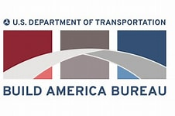
Phase Four-CAIPS and the USDOT
Project Development Discussions between CAIP Stakeholders-and USDOT Began In 2019
Project Designated a Regional Infrastructure Accelerator by USDOT in Fall 2021
Partnership with Build America Bureau
Development of a Public-Private Financing Structure
CAIP was identified as a “Project of Significance” in addressing supply chain challenges in recent agreement between USDOT-California

Slide 15
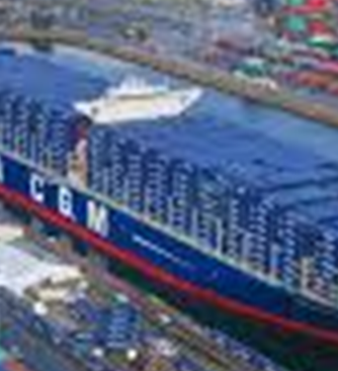
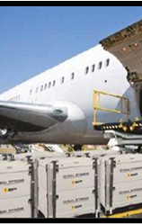
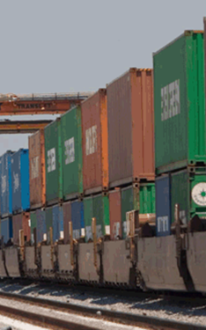
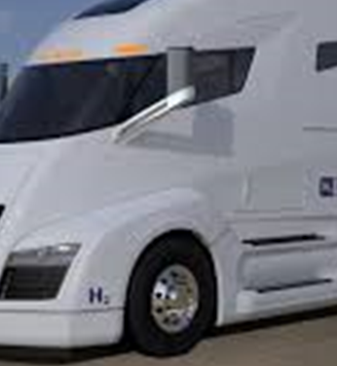
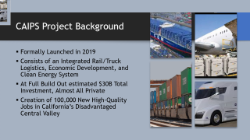
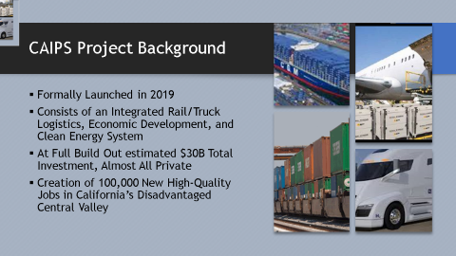
CAIPS Project Background
Formally Launched in 2019
Consists of an Integrated Rail/Truck Logistics, Economic Development, and Clean Energy System
At Full Build Out estimated $30B Total Investment, Almost All Private
Creation of 100,000 New High-Quality Jobs in California’s Disadvantaged Central Valley

Slide 16
Project Foundations
Seamless and Integrated System Solution
Logistics Connectivity
Clean Energy Platform
Modern Industrial Development
Economic Development Competitiveness
Development of TradePorts

Slide 17
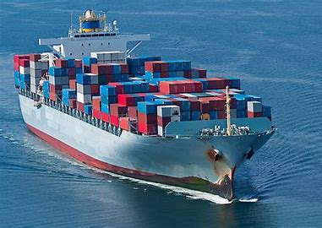
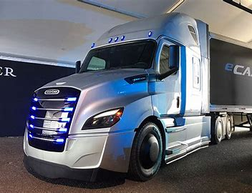
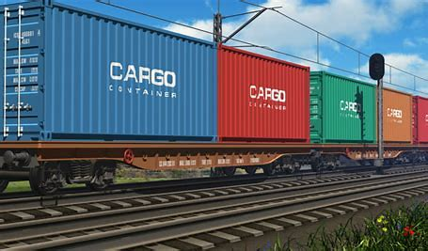
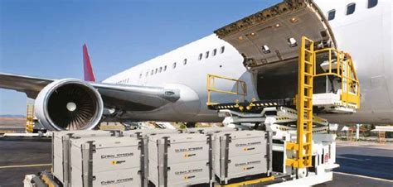
Requires An Engineered Integration of Project Development Across Modes
System Strategy (Defined in RIA Process)
Coordinated Public & Private Investments Are Critical
Extension of Seaport Logistics Hub Integrates:
  Rail Infrastructure
  Truck Mobility Complex’s
  Air Cargo Hub Access
  Highway/Road Investments

Slide 18
CAIPS Project Overview
Will Be Largest and Most Sophisticated Logistics Corridor in the World
  Integrated Multimodal Cargo Transport and Hubs
    Intermodal Truck and Rail Spine: Seaports to Markets
    Replaces All-Truck Conditions Currently
  TradePort Investment Districts
    Concentrated Centers For Economic Development Along Rail/Truck Spine
  Highly Efficient Cargo Movement
    Technology At The Center
  Clean Propulsion Platform
    Built Around Electric/Hydrogen Platform
    Catalyze The Shift

Slide 19







CA Inland Port System Delivery Team
Public Sector Manager and Coordinator
PM: Econ Dev/Clean Energy/P3/Logistics
Engineering, Planning, Clean Energy
Rail System Planning and Infrastructure
Telecom/Data Infrastructure
Legal/Public-Private Partnerships
Hydrogen Policy/Infrastructure
Truck Manufacturer/Clean Powertrain

Slide 20
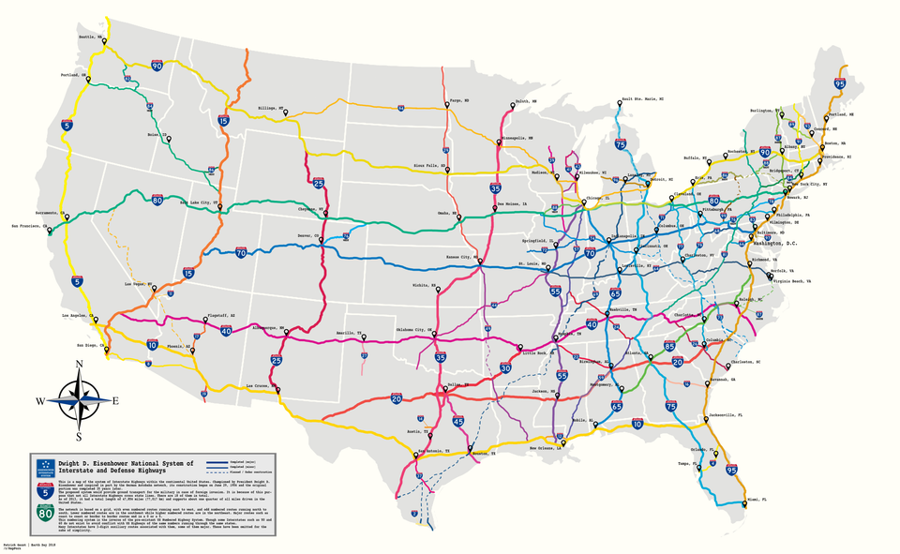
National Context
Major Port Feeder Corridors
Connecting California

Slide 21
Understanding Of An “Inland Port”
Common use of the term indicates a facility that is located away from traditional water ports that facilitates international trade through investments in multi-modal transportation assets and promotes value-added services as goods move through the supply chain.
The idea behind the California Inland Port System is to take these common facilities and integrate not just the efficient movement of goods, but “catalyze” an intersection between economic development, sustainable platforms, and next-generation technologies that produce a more resilient and stronger supply chain.
  Creating a system that is multi-dimensional and seamlessly functions as an extension of a seaport.
  Serves the 5th largest economy in the world.

Slide 22
Two “Elements” of CAIPS-
Trade Ports/Satellites
Total of 4 Tradeports in Study Area (SJV/Sacramento Regions)
Intermodal “Rail-Truck” Facilities
Requires proximity to Class One Railroad-State Highway
Total of 9 Satellites- “Truck only”-Truck Charging Facilities
Locations based on truck trip generation

Slide 23
CAIPS “Trade Ports”
Tradeports are rail-truck facilities that focus on the “intermodal” movement of goods----Imports/Exports
The Union Pacific and Burlington Northern Santa Fe railroads are Class One and generally run parallel to State Route 99 through the SJV and Sacramento regions.
The trucking element side of a Tradeport is called a Truck Mobility Complex
Tradeports will utilize “sustainable” energy (battery/hydrogen)
Tradeports must be located adjacent to a Class One railroad and a state highway or significant local road
Tradeports will be selected based on a set of evaluation criteria that places a priority on private sector needs-rail, shippers, trucking, etc. but will also take public sector issues into account
Tradeports will also have Truck Charging Facilities (battery/hydrogen) that are “not” dependent on the intermodal (rail/truck) dimension
Equivalent Distance From Washington DC to Boston Through 7 States and DC
Confidential

Slide 24
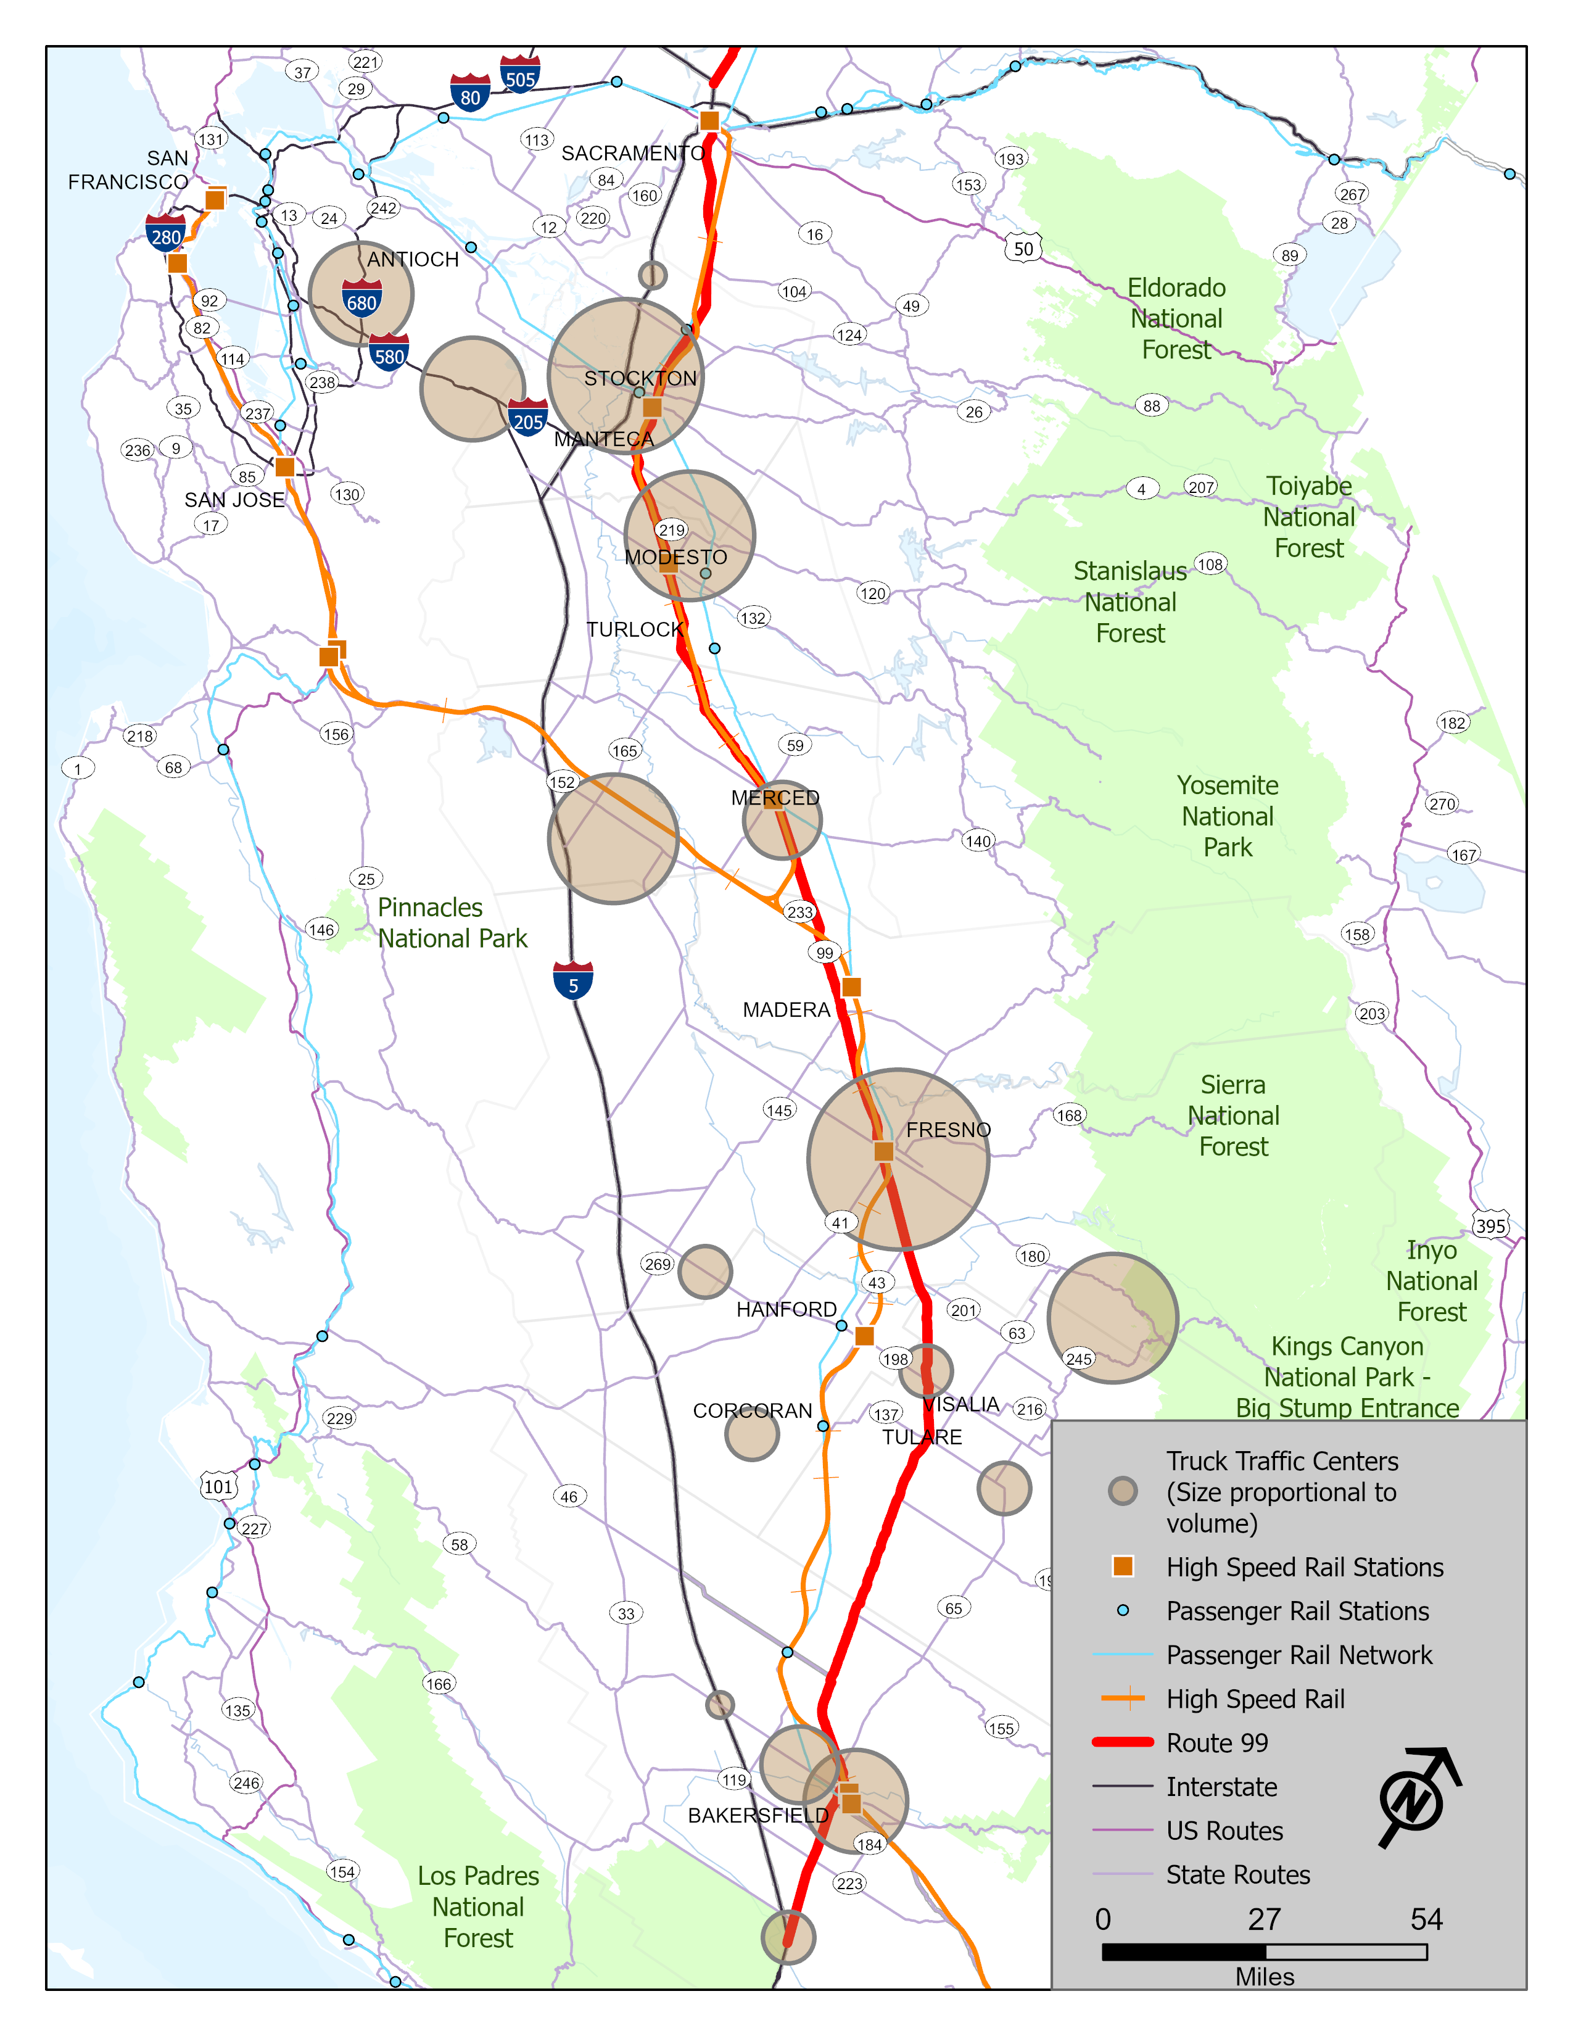
CAIPS “Satellites”
Inland Port “Satellites” are not required to be located adjacent to a Class One railroad
The purpose of the Inland Port satellites is to serve as network of electric truck charging facilities strategically located throughout the two regions
Equivalent Distance From Washington DC to Boston Through 7 States and DC
Confidential

Slide 25
CAIPS TradePort Hubs-Satellites
TradePort Logistics and Investment Zone
6000 ac*
TradePort Logistics Core
300 ac
Satellite TradePorts
*Depending on location
Confidential

Slide 26
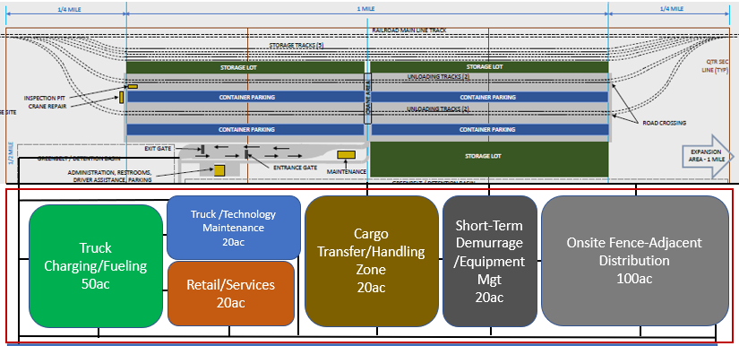
TradePort Logistics Core
Rail Intermodal
Truck Mobility Complex
Confidential

Slide 27
TradePort Logistics Core
Rail
Intermodal
Truck Mobility Complex
Storage Yard
For Empty Rail
Containers (Ag Export)
100ac
Confidential

Slide 28
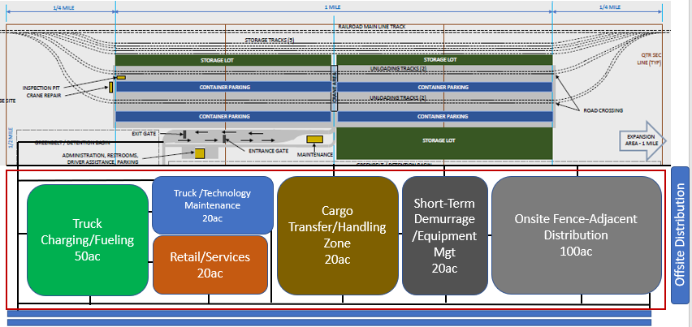
TradePort Asset Investment Diagram
Industrial Machinery Assembly
Regional Distribution
Food Processing
Rail Line
ECommerce
High-Efficiency Distribution
High-Efficiency Distribution
ECommerce
Seaports
TradePort Logistics Core
Highway
Pharma
Aerospace Product
Admin/Offices
Retail
Training Academy
Food Processing and Production
Auto
Tech
Air Cargo
Hub
Medical Products
Clean Energy
Electronics Products
Confidential

Slide 29
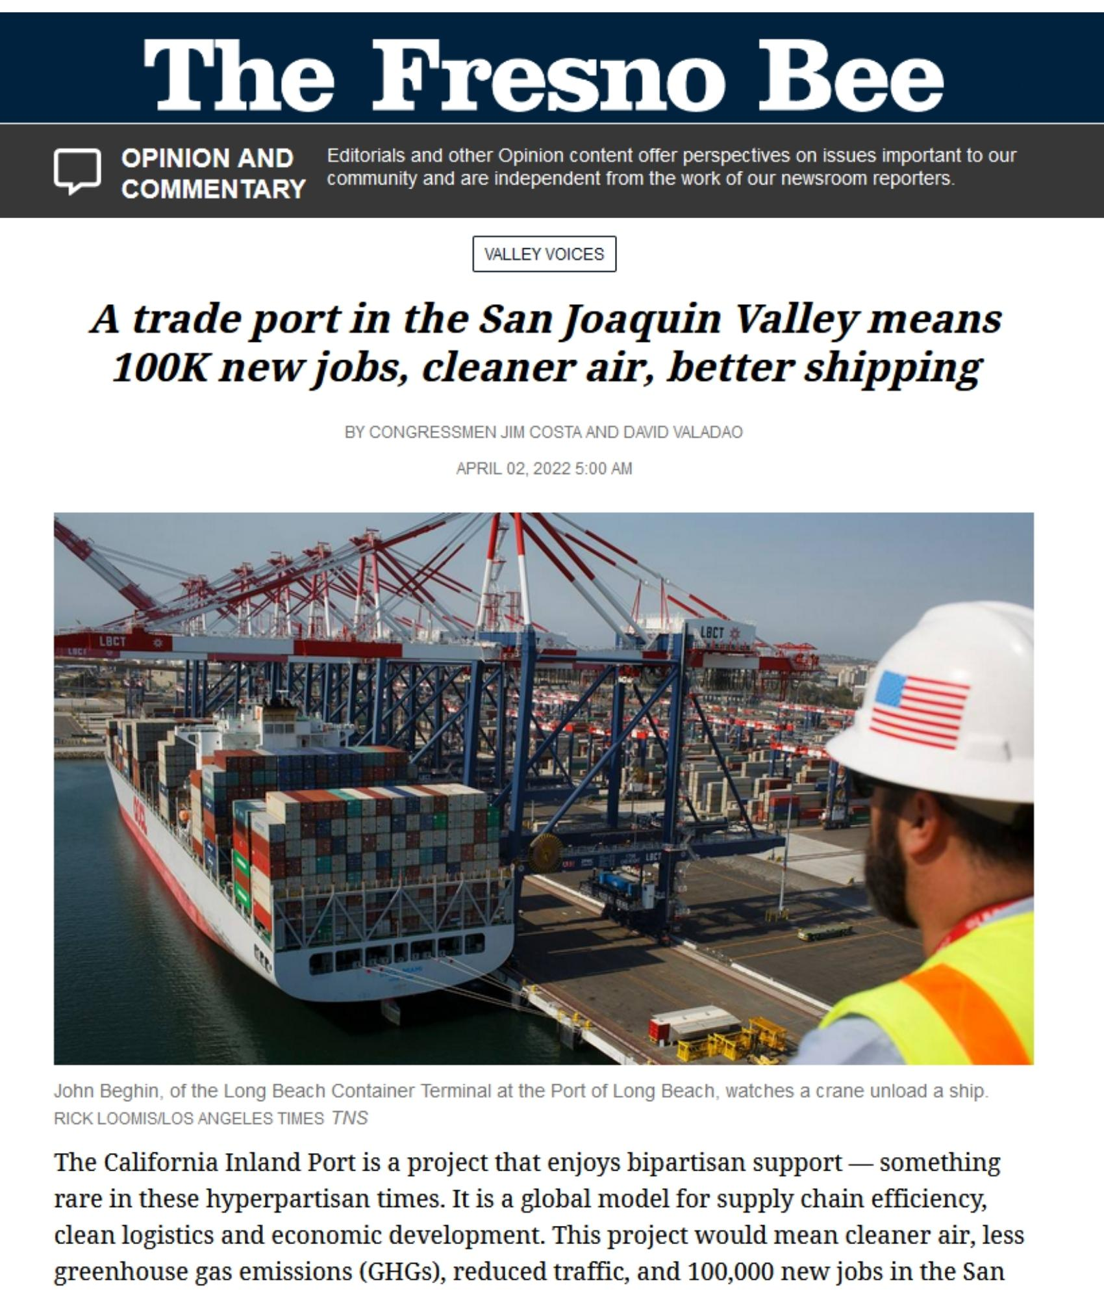
Bipartisan Support
Co-Authored Op-Ed by Congressmen Costa (D) and Valadao (R)
“Seldom do we see a project with so many benefits for the Valley, the state and the nation. We should approach with a sense of urgency.”
“Not just as a comprehensive north-south goods movement system, but also as an economic game-changer.”

Slide 30
CALSTA Port & Freight Infrastructure Grant Program
Historic $1.2 billion one-time program to help ease supply chain congestion and increase the capacity to move goods in California for 2022-2023 budget
Nearly $300 million is reserved for Innovative Pilot Projects
CALSTA is currently developing guidelines and aims to call for projects in October 2022
Grant applications due January 13, 2023.
Seeks to improve the capacity, safety, efficiency and resilience of goods movement to, from and through California’s maritime ports, while also reducing greenhouse gas emissions and harmful impacts to communities adjacent to the corridors and facilities used for goods movement which aligns with the Central Valley Inland Port System.

Slide 31
Project Going Forward
Finalize Organizational/Delivery Entity, Financing Structure Development, Establish Partners
Site Selection Begun, Acquire Sites, First TradePorts Under Construction, Clean Energy Deals In-Place, Risk Capital Investment Partners, Shipper/Partners Announced
All TradePort Sites Under Control, Operations Begun, Initial Development of Investment Districts
2022
2023
2024

Slide 32
Project Contact
Tony Boren, Executive Director, Fresno COG
  tboren@fresnocog.org
  559.233.4148 Ext 204
  sjhutti@fresnocog.org
  559.233-4148 Ext 217

